Slide 1
GLOBAL BANKING PORTFOLIO ANALYTICS & RISK OVERSIGHT
An executive-level overview of global banking operations, identifying solvency trends, credit risk concentrations, and regulatory compliance gaps to guide strategic portfolio management.
Prepared By
ADINATH C S

Slide 2
INTRODUCTION
The Global Banking Portfolio Analytics & Risk Oversight project is designed to evaluate balance sheet health, monitor credit exposure, and pinpoint regulatory gaps across our international customer base. By analyzing key variables—including debt-to-income ratios, credit scores, account tiers, and KYC verification statuses—this project provides the operational intelligence needed to guide strategic capital allocation, streamline compliance audits, and enforce risk guardrails globally.

Slide 3
DATASET OVERVIEW
Data Scope: 1,599 customer records across 19 feature attributes in 39 countries.
Demographic Identifiers: Full Name, Age, Gender, Location, and Account Creation Date.
Account Classification: 7 distinct tiers (Premium, Business, Joint, Savings, Current, Digital-Only, Student).
Financial Metrics: Quantitative fields for Balance (USD), Debt (USD), Income, and Credit Score (595–845).
Risk & Compliance Flags: Risk Level (High, Medium, Low), KYC Status (Verified, Pending), Fraud Flag, and Account Status.

Slide 4
OBJECTIVES
Solvency: Ensuring our balance sheet maintains a strong liquidity buffer above 2.0x
Credit Risk: Pinpointing high-default borrower clusters where DTI exceeds 40% and credit scores drop below 650.
Compliance: Auditing KYC statuses to eliminate AML penalties.
Segment Performance: Tracking asset drivers and liability risks across our account tiers.
Geographic Allocation: Directing capital and strategic focus toward our top asset-generating global markets.

Slide 5
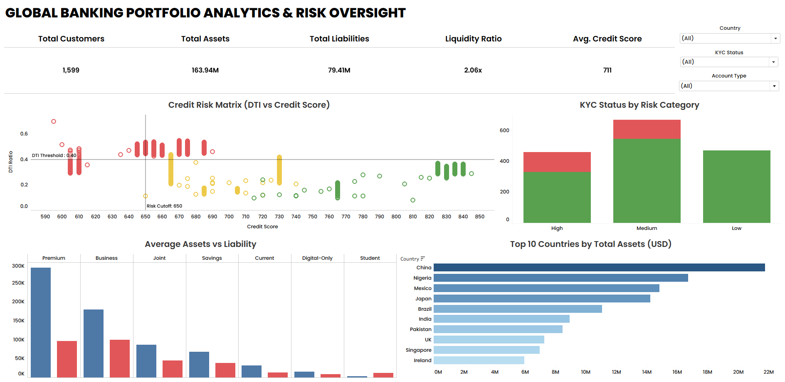
DASHBOARD

Slide 6
DASHBOARD KEY INSIGHTS
Solvency: $116.07M in assets vs. $54.25M in liabilities provides a healthy 2.06x liquidity ratio.
Credit Exposure: A key cluster breaches both risk thresholds (DTI > 0.40 and Credit Score < 650).
Compliance Gap: 127 high-risk accounts remain in pending KYC status, presenting AML audit exposure.
Account Tiers: Premium accounts drive highest total assets (~$290K avg), while Business accounts carry the highest liabilities (~$100K avg).
Regional Markets: Capital concentration is led by China ($21.8M), Nigeria ($16.7M), Mexico ($14.8M), and Japan ($14.2M).

Slide 7
CONCLUSION
Capital Solvency: Our portfolio displays strong baseline stability with $116.07M in assets against $54.25M in liabilities, maintaining a healthy 2.06x liquidity ratio.
Credit Exposure: While average credit scores remain solid at 711, underwriting risks are tightly concentrated in borrowers breaching our 0.40 DTI threshold and falling below the 650 credit score cutoff.
Compliance Vulnerability: Our most urgent operational gap is the 127 High-Risk accounts sitting in pending KYC status, which require immediate containment to mitigate AML audit exposure.
Strategic Growth: Wealth management expansion is heavily driven by Premium account holders and anchored across our top four markets—China, Nigeria, Mexico, and Japan.

Slide 8
FUTURE ENHANCEMENT
Predictive Default Risk: Implement simple predictive models to flag customers at high risk of loan default before they breach DTI limits.
Automated Data Updates: Connect the dashboard directly to a live database to update metrics automatically in real time.
Automated KYC Alerts: Trigger instant email notifications to compliance teams whenever a high-risk account enters pending KYC status.
Granular Location Tracking: Expand geographic analysis from country-level to city-level views to identify local risk clusters.

Slide 9
THANK YOU

